Slide 1
Steganography Hiding information in plain sight
Chris Roberts
Craig Russell

Slide 2

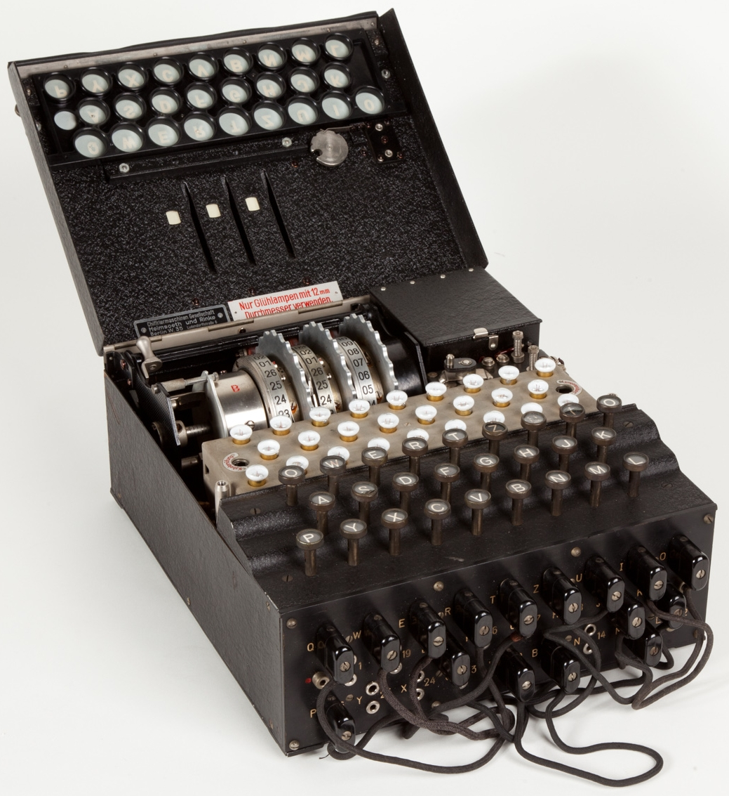
Steganography
Steganos – covered/secret
Hides the location of information
Locational key
Invisible ink
Cryptography
Krytpos – secret/hidden
Hides the translation of information
Mathematical key
German Enigma Machine
Notes:
Craig

Slide 3
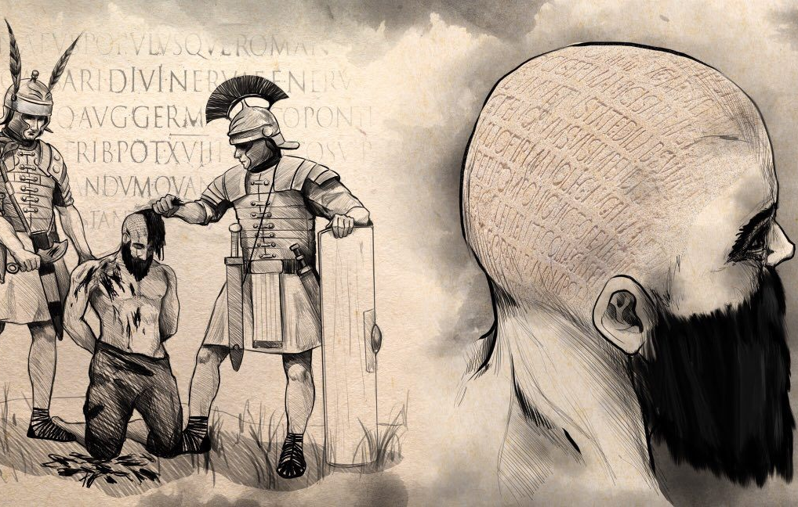
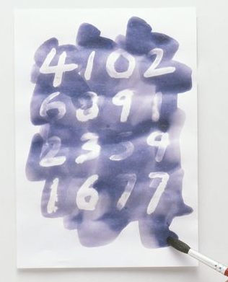
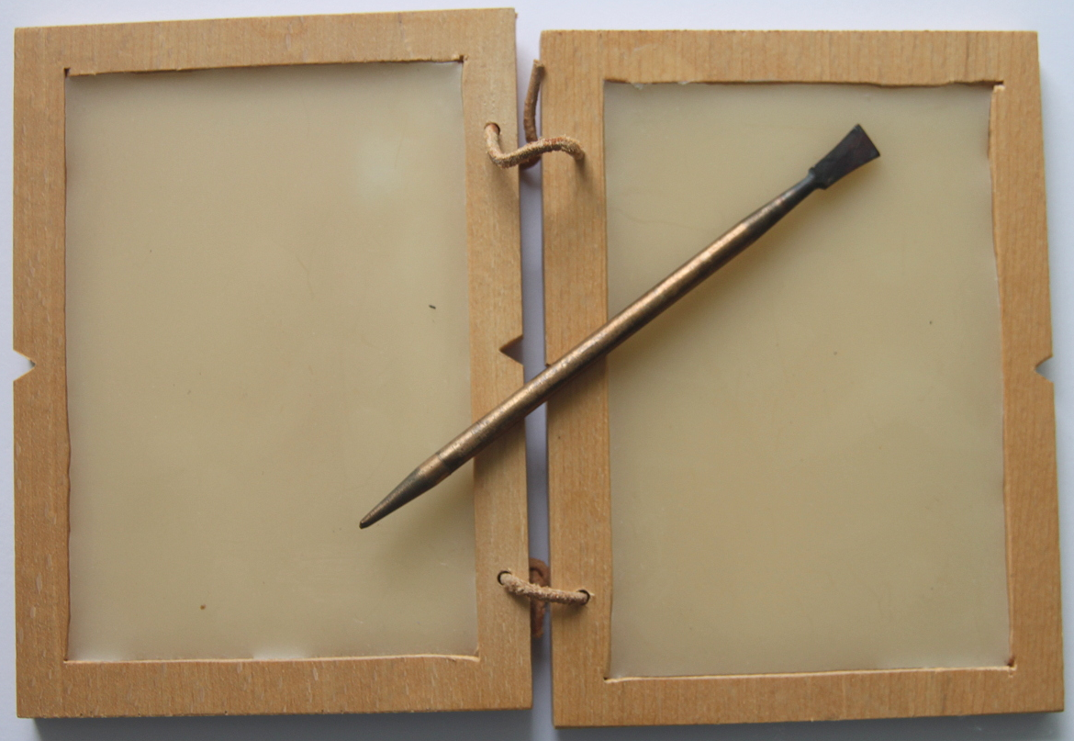
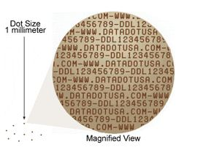
Historical context
~500 BC – Greeks tattooed onto shaved head
480 BC – Spartans wax tablets
1776 – Revolutionary war invisible ink
1940s – WWII Microdots
Notes:
Chris

Slide 4
Steganography Intro Activity
Find all 5 hidden messages.
Steganography hides information using a variety of methods. UnlikE encryption, who’s only goAl is to obscure data, hidden data is able to carry large amountS of information without detection. Methods for redirecting one’s attention can be used to further hide information. EarlY uses include changing typefaces and fonts in a block of text and tattooing a message onto the head of a slave.
______ ______ isn’t ______ to ________, ________________.
but some messages are harder to find than others
Notes:
Chris explains, Craig passes out

Slide 5


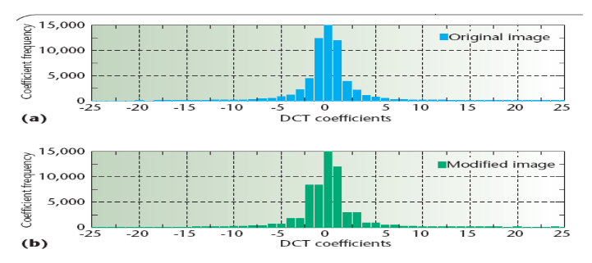
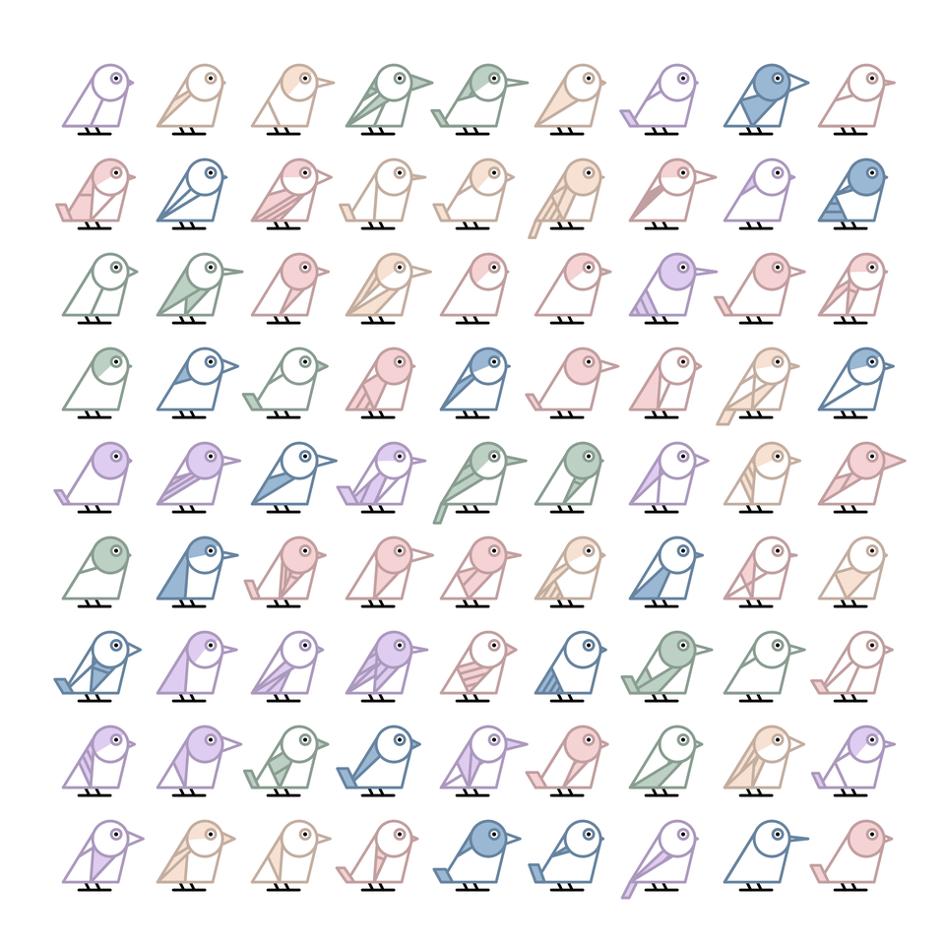

Steganographic Techniques
Using noise
Spreading out information
Adopting a statistical profile
Replacing procedural generation
with information
Changing orders of lists
Splitting information
Hiding the source
Notes:
Mix

Slide 6
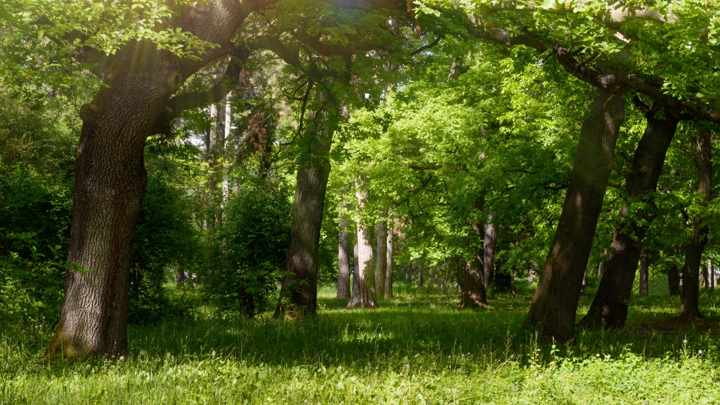

Digital Image Steganography
Information can be stored inside media files
Making small changes that will be indiscernible from the original
Common approach is to use LSBs
Notes:
Chris

Slide 7


Digital Image Steganography
RGB values from 0-255
Binary: “0000 0000”
Pixel = Pixel – (Pixel mod 4)
Ex: 255 => 252
Take two bits of message image
Replace last two bits of original
Notes:
Chris

Slide 8

Digital Image Steganography
1280x720 = 921,600 pixels
4:1 pixel ratio
480x480 = 230,400 pixels
Notes:
Chis

Slide 9
How it works - Encryption
Image file types
Reading in original image and hidden image
Rip pairs of bits from hidden image
HiddenPixel[u,v] = nextTwoBits()
Ex: 147 = 10010011 → (1,0), (0,1), (0,0), (1,1)
For each original pixel, replace the last two bit with two bits from the hidden image
SteganogramPixel = OrignalPixel[7,2] + HiddenPixel[u,v]
Output steganographic image
Notes:
Craig

Slide 10
How it works - Decryption
Read in Steganogram
For each pixel in Steganogram, rip bottom two bits off
MessageBits[u,v] = lastTwoBits()
Ex: 147 = 10010011 → (1,1)
Stitch all the bit pairs back together
HiddenPixel = MessageBits[u,v] .. MessageBits[u+1,v+1] .. MessageBits[u+2,v+2] .. MessageBits[u+3,v+3]
Output hidden image
Notes:
Craig

Slide 11
Significance
Good: Digital watermarking
Bad: Hypothetical app
How much data can you store in 4K movies…?

Slide 12


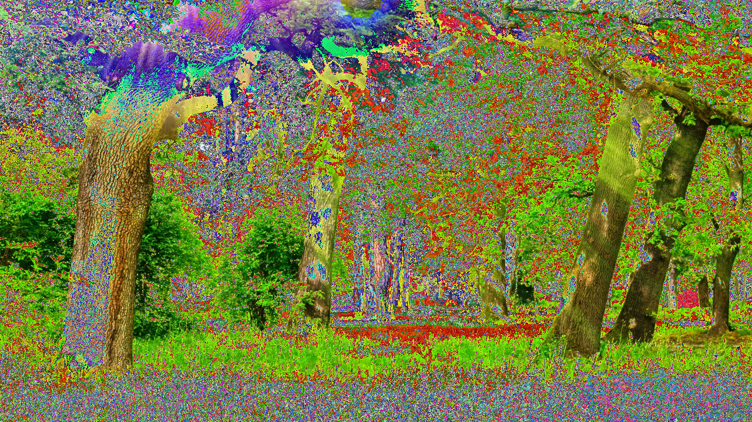
Questions?
Questions?

